Slide 1

AUTOMATED SHOPPING CART

Slide 2

INSTITUTION : DEDAN KIMATHI UNIVERSITY OF TECHNOLOGY
SCHOOL : SCHOOL OF ENGINEERING
_{DEPARTMENT: MECHATRONICS}
COURSE: BSc. MECHATRONIC ENGINEERING
_{UNIT NAME: PROJECT 1}
_{UNIT CODE: EMT 5101}
TITLE : AUTOMATED SHOPPING CART
SUPERVISOR: DR. SAM MACHARIA KANG’IRI

Slide 3
GROUP MEMBERS
FLORENCE ODERO E022-01-1067/2020
EMMANUEL KAPKONI E022-01-1077/2020
COLLINS KIPLAGAT E022-01-1078/2020
FIDEL KIREGA E022-01-0777/2020
MWANGI MILTON KIAI E022-01-2151/2020
MANJARI DAVID E022-01-0786/2019

Slide 4
PROBLEM STATEMENT
Background: During traditional shopping, patrons choose their own products, load them into a cart, and then pay at a register. Customers and retailers may experience inefficiencies as a result of this laborious and error-prone process.
Problem statement: Create and optimize an automated shopping cart system that expedites checkout times and boosts overall efficiency by automating the tracking, payment, and item selection processes.
Scope: The system's primary goal is to automate the tracking and selection of goods in a retail setting. It will have functions like tracking, item detection, improved security features, improved data analytics and reporting and a smooth checkout procedure.

Slide 5
OBJECTIVES
Improve on the previous design by making a fully fledged PCB:
Create a working schematic of the prototype, and its equivalent PCB
This is done by developing a custom printed circuit board to integrate all components, enhancing reliability, reducing wiring complexity, and ensuring a professional, scalable design.
2. Change from previous non-rechargable battery to a rechargeable battery with a battery management system
Design and creation of a working charging system of the battery

Slide 6
Replace the current power supply with a rechargeable lithium battery equipped with a Battery Management System (BMS) to ensure safe and efficient charging, extended battery life, and reliable power management.
3. . Design a 3D casing for the pcb for optimal protection
Mainly aimed at improving the customer experience by adding a unique and ergonomic device.

Slide 7
OBJECTIVES
Optimize the design with a compact microcontroller
This consists main microcontroller used to manage the hardware components and process data and a microcontroller with Wi-Fi and Bluetooth capabilities used for wireless communication and real-time data transfer.
5. Integrate with a web application

Slide 8
Develop a backend system for data analytics, providing insights into shopping patterns, customer preferences, and system performance, which can be used to further optimize the system and enhance customer experience.
Modular design approach
Design the cart with modular components that can be easily replaced or upgraded, facilitating maintenance and future improvements.
7. Improving security and compliance

Slide 9
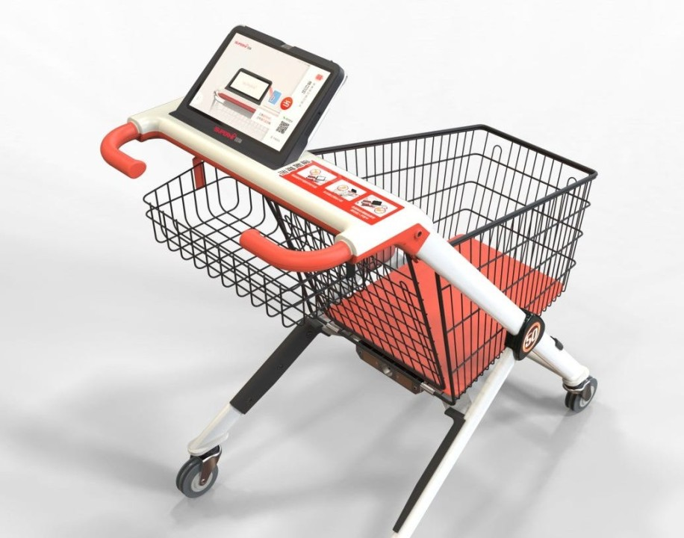
THANK YOU

